Slide 1

FINANCE
Bank loan of customer

Slide 2




CORDINATORS
Ajarul
Ankita
Ajay
Vaibhav
Ravi

Slide 3
Agenda or KPI’s
Year wise loan amount status
Grade and subgrade wise revol_bal
Total payment for verified status total payment for non verified status
State wise month wise loan status
Home ownership vs last payment date status

Slide 4
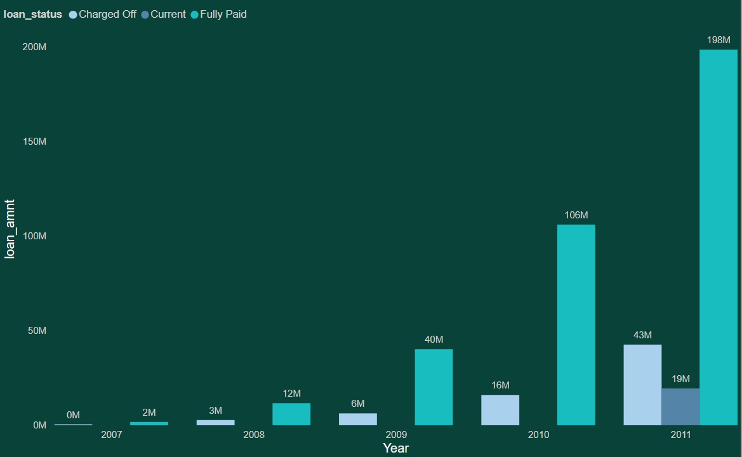
Year wise loan status
Conclusion
Annual income
As per the report annual income of 2011 is less compare to other years which is 61k so charged off amount is also high
Same here in the year of 2007 AVG annual income is 80k so the charged of amount also less
Purpose
Here who have taken highest amount of loan for the purpose of debt consolidation
They have the Highest paid up and charged off
For the credit card purpose has recovered the full amount

Slide 5
2. Grade and subgrade wise revol_bal
Conclusion
Home ownership
The maximum Revol_bal is coming under Garde ‘B’ under the B grade subgrade ‘B3’ which is 40 M
Now we can see by following the home ownership of Mortgage is having the maximum amount of Revol_bal under the subgrade of ‘B3’
Highest amount of revol_bal is left if we see the by analysis who all are coming under mortgage, rented
The lowest Revol_bal is Grade ‘G’ & subgrade ‘G5’

Slide 6
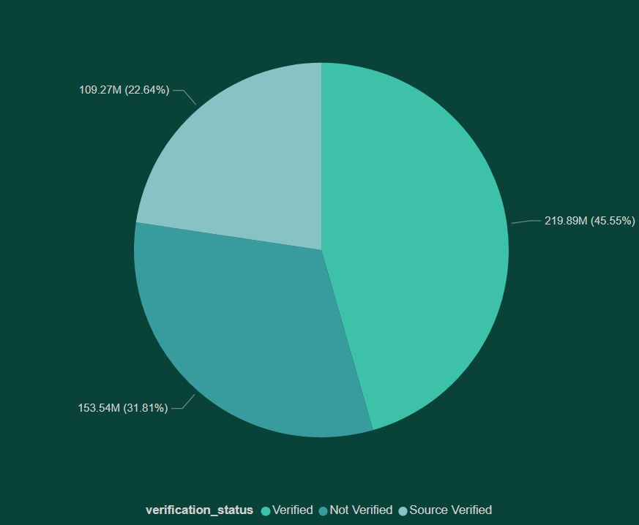
3. Total payment for verified status vs total payment of non verified status
Conclusion
Add_state
As we saw by the depth analysis is the state of ‘CA’ is having total payment of verified status and no verified status as we know they have the highest amount of loan
Purpose
Under the purpose who all have taken the loan for Debt consolidation .The total amount of verified status is High as well as no verified total amount is also high
Low verified & non verified status is under the purpose of ‘renewable energy’
Loan status
The total payment of verified and non verified is mostly depend on the status of loan
We got to know the ‘fully paid’ status is having the highest amount of verified where the less amount of non verified is in under ‘current’ status
Also years

Slide 7
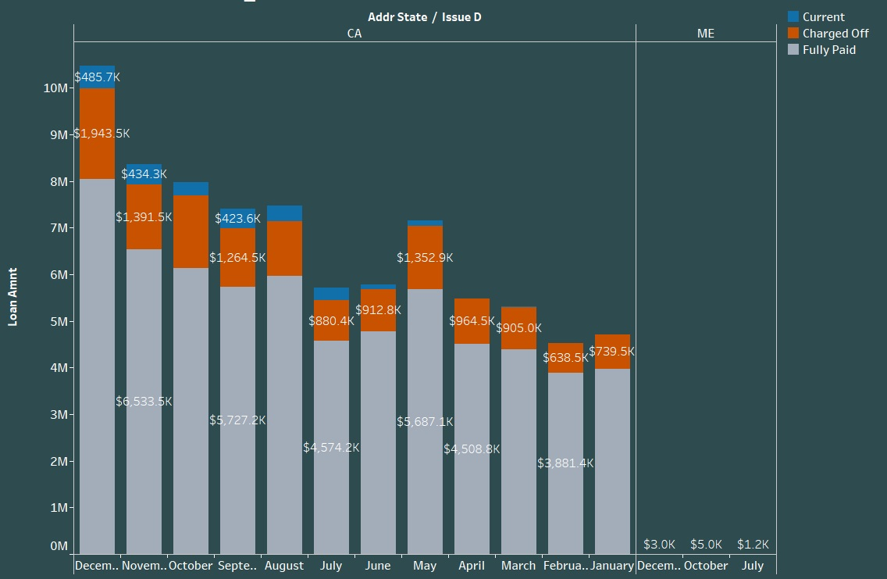
4. State wise month wise loan status
Conclusion
As we see the loan status of ‘CA’ is higher in the month of “Dec” which is ‘64M’ compare to another state where the ‘ME’ state is having the less amount of loan in the month of ‘Dec’ which is 3k
Annual income
The state of ‘CA’ is having the highest Avg annual income which is approx. ‘106989k’ . Where the ‘ME’ state is very less compare to ‘CA’
So the as per the ‘CA’ state Annual Income their requirement is also high as well as recoveries also
Terms
36 months: Highest amount of loan and & status as per the annual income
60 months : they have taken the loan as per this terms because of avg annual income is also less

Slide 8
5. Home ownership vs last payment date status
Conclusion
The highest last amount on the last date has received under the ownership of “Mortgage & rent” where the less amount has received from “owner”.
As we know the mortgage is taken the highest loan compare to others owner ship so the last payment is also high .
Purpose
By the analysis got to know the mortgage has taken the loan and their most of the purpose of ‘debt consolidation’
Rented ownership are having the highest credit purpose payment and loan amount taken .

Slide 9
Thank you

